Slide 1
Rational Unified Process (RUP)
概述

Slide 2

Outline
Introduction to RUP
Implementing Best Practices
Phases, Iterations, Workflows and Activities
The Iteration Process in RUP
Planning a RUP Project
Tailoring and Implementing RUP
RUP vs. CMMI

Slide 3
What is RUP
Process Framework and a detailed prescriptive process model
  Meta Process / Must customize
Software engineering knowledge base
  Covers almost all activities of software development
Well defined structure for object-oriented design and development
  Based on OO and UML
Like a software product, the Rational Unified Process is designed and documented using the Unified Modeling Language (UML)
  Well documented

Slide 4
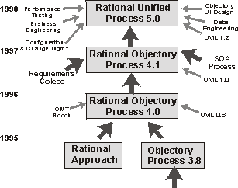
A Brief History of RUP
Notes:
The RUP has matured over many years and reflects the collective experience of the many people and companies. Let us have a quick look at the process’s ancestry, as illustrated in the figure below.
Going backwards in time, the RUP is the direct successor to the Rational Objectory Process (version 4). The RUP incorporates more material in the areas of data engineering, business modeling, project management, and configuration management, the latter as a result of the merger with Pure-Atria. It also brings a tighter integration to the Rational Software suite of tools.
The Rational Objectory Process was the result of the integration of the “Rational Approach” and the Objectory process (version 3), after the merger of Rational Software Corporation and Objectory AB in 1995.
From its Objectory ancestry, the process has inherited its process structure and the central concept of use case. From its Rational background, it gained the current formulation of iterative development and architecture. This version also incorporated material on requirements management from Requisite, Inc. and a detailed test process inherited from SQA,® Inc., companies which also merged with Rational Software.
Finally, this process was the first one to use the newly created Unified Modeling Language (UML 0.8). The Objectory process was created in Sweden in 1987 by Ivar Jacobson as the result of his experience with Ericsson. This process became a product at his company, Objectory AB. Centered around the concept of use case and an object-oriented design method, it rapidly gained recognition in the software industry and has been adopted and integrated by many companies worldwide. A simplified version of the Objectory process was published as a text book in 1992.
The RUP is a specific and detailed instance of a more generic process described by Ivar Jacobson, Grady Booch, and James Rumbaugh in the textbook, The Unified Software Development Process.

Slide 5
Move Toward the Future…
Rational started plans late in 2000 to develop the RUP into an industry-wide platform for best practices
  RUP want to be a process that could meet the needs of even the most specialized software development organizations, yet remain accessible to the many types of practitioners working on various phases of the software development life cycle.
  Now IBM Rational Software…

Slide 6
Outline
Introduction to RUP
Implementing Best Practices
Phases, Iterations, Workflows and Activities
The Iteration Process in RUP
Planning a RUP Project
Tailoring and Implementing RUP
RUP vs. CMMI

Slide 7
Rational Unified Process
Describes the effective implementation of key “Best Practices”
Manage Requirements
Develop
Iteratively
Use
Component
Architectures
Model
Visually
Verify
Quality
Control Changes

Slide 8
1. Develop Software Iteratively
  An initial design will likely be flawed with respect to its key requirements
  Late-phase discovery of design defects results in costly over-runs and/or project cancellation
The time and money spent implementing a faulty design
are not recoverable

Slide 9
Waterfall Development
Requirements
Analysis
Design
Code & Unit
Testing
Subsystem
Testing
System Testing
T I M E

Slide 10
Waterfall Development: Risk vs. Time
Requirements
Analysis
R
I
S
K
Design
Code & Unit
Testing
Subsystem
Testing
System Testing
T I M E

Slide 11
Iterative Development
Requirements
Analysis & Design
Planning
Implementation
Initial
Planning
Management
Environment
Deployment
Evaluation
Test
Each iteration results in an executable release

Slide 12
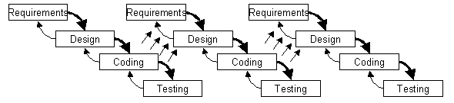
An Iterative Development Lifecycle

Slide 13
Risk Profile of an Iterative Development
Waterfall
Inception
Elaboration
RISK Reduction
Risk
Construction
Transition
Preliminary
Iteration
Architect.
Iteration
Architect.
Iteration
Devel.
Iteration
Devel.
Iteration
Devel.
Iteration
Transition
Iteration
Transition
Iteration
Post-
deployment
Time
Risks - process, technology, teamwork, customer, business domain

Slide 14
Iterative Development Characteristics
  Critical risks are resolved before making large investments
  Initial iterations enable early user feedback
  Testing and integration are continuous
  Objective milestones provide short-term focus
  Progress is measured by assessing implementations
  Partial implementations can be deployed

Slide 15

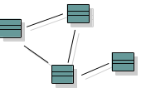

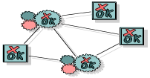
2. Manage Your Requirements
Elicit, organize, and document required functionality and constraints
Track and document tradeoffs and decisions
Business requirements are easily captured and communicated through use cases
Use cases are important planning instruments
Use-Case Model
realization
influenced by
verifies
Use Cases drives the work from analysis through test
Design Model
Implementation Model
Test Model

Slide 16
3. Employ Component-based Architecture
Design, implement and test your architecture up-front!
A systematic approach to define a “good” architecture
  resilient to change by using well-defined interfaces
  by using and reverse engineering components
  derived from top rank use cases
  intuitively understandable
Application-
specific
Business-
specific
Component-based Architecture with layers
Middleware
System-
software

Slide 17



4. Model Software Visually
Capture the structure and behavior of architectures and components
Show how the elements of the system fit together
Maintain consistency between a design and its implementation
Promote unambiguous communication
Sub Systems
Visual Modeling
raises the level
of abstraction
Classes
Code

Slide 18
5. Verify Software Quality
Create tests for each key scenario to ensure that all requirements are properly implemented
Unacceptable application performance hurts as much as unacceptable reliability
Verify software reliability - memory leaks, bottle necks
Test every iteration - automate test!
Cost
Software problems
are 100 to 1000 times
more costly to find
and repair after deployment
Development Deployment

Slide 19

6. Control Changes to Software
Control, track and monitor changes to enable iterative development
Establish secure workspaces for each developer
  Provide isolation from changes made in other workspaces
  Control all software artifacts - models, code, docs, etc.
Automate integration and build management
Workspace
Management
Parallel
Development
CM is more than just check-in and check-out
REPORT
ALERT
Build
Management
Process
Integration

Slide 20

Rational Unified Process
Provides guidelines, templates and tool mentors for the effective implementation of key best practices
Delivered through a web-enabled searchable knowledge base
Manage Requirements
Develop
Iteratively
Verify
Quality
Use
Component
Architectures
Model
Visually
Control Changes

Slide 21
Outline
Introduction to RUP
Implementing Best Practices
Phases, Iterations, Workflows and Activities
The Iteration Process in RUP
Planning a RUP Project
Tailoring and Implementing RUP
RUP vs. CMMI

Slide 22
The RUP Architecture
Time
Phases
Process Workflows
Inception
Elaboration
Construction
Transition
Business Modeling
Requirements
Analysis & Design
Content
Implementation
Test
Deployment
Supporting Workflows
Configuration Mgmt
Management
Environment
Preliminary
Iteration(s)
Iter.
#1
Iter.
#2
Iter.
#n
Iter.
#n+1
Iter.
#n+2
Iter.
#m
Iter.
#m+1
Iterations
Notes:
The RUP can be described in two dimensions, or along two axis:
the horizontal axis represents time and shows the dynamic aspect of the process as it is enacted, and it is expressed in terms of cycles, phases, iterations, and milestones.
Describes the process in terms of how the process rolls out over time
the vertical axis represents the static aspect of the process: how it is described in terms of activities, artifacts, workers and workflows.
Describes the process in terms of who is doing what, how, and when

Slide 23
Phases and Iterations - The Time Dimension
Major
Milestones
Inception
Elaboration
Construction
Transition
time
The Rational Unified Process has four phases:
  Inception - Define the scope of project
  Elaboration - Plan project, specify features, baseline architecture
  Construction - Build the product
  Transition - Transition the product into end user community
Notes:
The iterative lifecycle of the RUP is partitioned in a different set of phases than the waterfall lifecycle. These new phases cannot be named after a type of activity (such as "design"), since these activities will be repeated, or a kind of artifact (such as "requirement"), since the artifacts will be evolving over several iterations and phases.
Note the key difference in terminology (which tends to confuse people): What the waterfall lifecycle calls phases (requirements, design, and so on) are only types of activities (or disciplines) in the RUP. If it bothers you that the RUP calls Inception, Elaboration, Construction, and Transition phases, then you can refer to them as stages, for example, and steer clear of the word phase. In the RUP, a cohesive set of activities is called a discipline, not a phase: Analysis and Design, for example, is a discipline.

Slide 24
Inception Phase
  Purpose
    To establish the business case for a new system or for a major update of an existing system
    To specify the project scope
  Outcome
    A general vision of the project’s requirements, i.e., the core requirements
      Initial use-case model and domain model (10-20% complete)
    An initial business case, including:
      Success criteria (e.g., revenue projection)
      An initial risk assessment
      An estimate of resources required
  Lifecycle Objectives Milestone

Slide 25
Elaboration Phase
  Purpose
    To analyze the problem domain
    To establish a sound architectural foundation
    To address the highest risk elements of the project
    To develop a comprehensive plan showing how the project will be completed
  Outcome
    Use-case and domain model 80% complete
    An executable architecture and accompanying documentation
    A revised business case, incl. revised risk assessment
    A development plan for the overall project
  Lifecycle Architecture Milestone

Slide 26
Construction Phase
  Purpose
    To incrementally develop a complete software product which is ready to transition into the user community
  Products
    A complete use-case and design model
    Executable releases of increasing functionality
    User documentation
    Deployment documentation
    Evaluation criteria for each iteration
    Release descriptions, including quality assurance results
    Updated development plan
  Initial Operational Capability Milestone

Slide 27
Transition Phase
  Purpose
    To transition the software product into the user community
  Products
    Executable releases
    Updated system models
    Evaluation criteria for each iteration
    Release descriptions, including quality assurance results
    Updated user manuals
    Updated deployment documentation
    “Post-mortem” analysis of project performance
  Product Release Milestone

Slide 28
Resource Needs
Resources
More up-front effort for difficult projects
65%
10%
20%
5%
Time
Inception
10%
Elaboration
30%
Construction
50%
Transition
10%

Slide 29
Iterations
Minor Milestones:
Releases
Inception
Elaboration
Construction
Transition
Preliminary
Iteration
Architect.
Iteration
Architect.
Iteration
Devel.
Iteration
Devel.
Iteration
Devel.
Iteration
Transition
Iteration
Transition
Iteration
Each phase in the RUP can be further broken down into iterations.
An iteration is a complete development loop resulting in a release (internal or external) of an executable product, a subset of the final product under development, which grows incrementally from iteration to iteration to become the final system.

Slide 30
Static Structure of the RUP
A process describes who is doing what, how, and when. The Rational Unified Process is represented using four primary modelling elements:
      Workers, the "who"
      Activities, the "how"
      Artifacts, the "what"
      Workflows, the "when"
Notes:
Explain RUP vs Unified Process:
Unified Process is the generic process/standard with OMG support.
The Rational Unified Process as an exemplar of the Unified Process
See Rational Unified Process 2000 - Overview and Requirements Workflow. The RUP 2000 is available on the machines in the labs. It comprises a large number of html pages.

Slide 31
RUP Terminology
Worker
  a Role played by individuals on a project
  some people have many roles
Activity
  a unit of work with a clear purpose, broken down into steps
  small, definable, reusable tasks that can be allocated to a single worker
Artifact
  a work product produced as a result of an activity
  usually process deliverables, like: use cases, code, plans, test cases, test results
Workflow
  ‘The sequence of activities performed in a business that produces a result of observable value to an individual actor of the business. ‘
  coordinated sequences of activities
Notes:
Workers have a set of cohesive activities which they perform. These activities are closely related and functionally coupled, and are best performed by the same individual.
Activities are closely related to artifacts: artifacts provide the input and output for the activities, and provide the mechanism by which information is communicated between activities.
Artifacts are either final or intermediate work products that are produced and used during a project. Artifacts are used to capture and convey project information. An artifact can be any of the following:
A document, such as Business Case or Software Architecture Document
A model, such as the Use-Case Model or the Design Model
A model element, i.e. an element within a model, such as a class, or a subsystem

Slide 32
Process Notation
Describes a piece of work a worker may be asked to perform.
Activity
Worker
Signifies a role that may be played by an individual or a team of individuals in the development organization
Use-Case
Describe a
Use Case
Specifier
responsible for
Artifact
Signifies a piece of information that is produced, modified, or used by a process
Use Case
Use-Case
Package

Slide 33
Workers Are Used for Resource Planning
R
e
s
o
u
r
c
e
W
o
r
k
e
r
A
c
t
i
v
i
t
i
e
s
P
a
u
l
D
e
s
i
g
n
e
r
D
e
f
i
n
e
O
p
e
r
a
t
i
o
n
s
.
.
.
M
a
r
y
U
s
e
-
C
a
s
e
S
p
e
c
i
f
i
e
r
D
e
s
c
r
i
b
e
a
U
s
e
C
a
s
e
.
.
.
J
o
e
U
s
e
-
C
a
s
e
D
e
s
i
g
n
e
r
D
i
s
t
r
i
b
u
t
e
B
e
h
a
v
i
o
r
.
.
.
S
y
l
v
i
a
D
e
s
i
g
n
R
e
v
i
e
w
e
r
R
e
v
i
e
w
U
s
e
-
C
a
s
e
M
o
d
e
l
.
.
.
S
t
e
f
a
n
A
r
c
h
i
t
e
c
t
D
e
f
i
n
e
U
s
e
-
C
a
s
e
V
i
e
w
D
e
f
i
n
e
L
o
g
i
c
a
l
V
i
i
e
w
.
.
.
Each individual in the project is assigned to one or several workers

Slide 34
RUP Workflows
A workflow is a sequence of activities that produces a result of observable value.
There are 9 workflows, which represent a partitioning of all workers and activities into logical groupings
  6 engineering workflows:
    Business modelling
    Requirements
    Development & Analysis
    Implementation
    Test
    Deployment
  And 3 supporting workflows:
    Project management
    Configuration and Change Management
    Environment

Slide 35
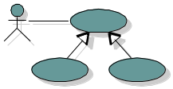

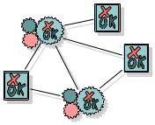
Models and Workflows
Each major workflow describes how to create and maintain a particular model
Business
Modeling
Business Model
Requirements
Workflow
realized by
Analysis Design
Workflow
Use-Case
Model
implemented by
Design
Model
Implementation
Workflow
verified by
Implementation
Model
Test Workflow
Test
Model

Slide 36
Bringing It All Together...
In an iteration, you walk through all workflows
Phases
Process Workflows
Inception
Elaboration
Construction
Transition
Business Modeling
Requirements
Analysis & Design
Implementation
Test
Deployment
Supporting Workflows
Configuration Mgmt
Management
Workflows group activities logically
Environment
Preliminary
Iteration(s)
Iter.
#1
Iter.
#2
Iter.
#n
Iter.
#n+1
Iter.
#n+2
Iter.
#m
Iter.
#m+1
Iterations

Slide 37
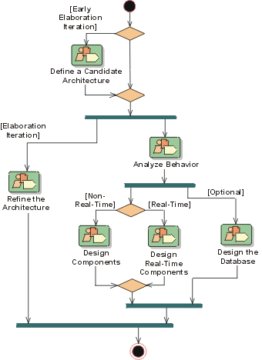
Example: The Analysis & Design Workflow
Notes:
The purposes of Analysis & Design are:
To transform the requirements into a design of the system to-be.
To evolve a robust architecture for the system.
To adapt the design to match the implementation environment, designing it for performance.
The Analysis & Design workflow is related to other process workflows.
The Business Modeling workflow provides a organisational context for the system.
The Requirements workflow provides the primary input for Analysis and Design.
The Test workflow tests system designed during Analysis and Design.
The Environment workflow, develops and maintains the supporting artifacts that are used during Analysis and Design.
The Project Management workflow plans the project, and each iteration (described in an Iteration Plan).

Slide 38
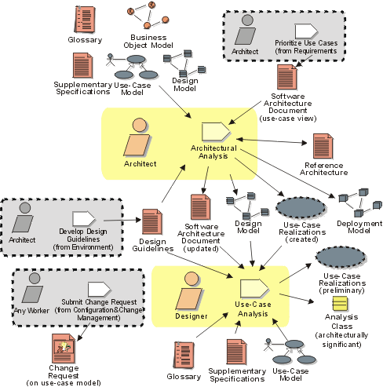
Workflow Detail: Define a Candidate Architecture
Notes:
The purpose of this workflow detail is to:
Create an initial sketch of the architecture of the system
Define an initial set of architecturally significant elements to be used as the basis for analysis
Define an initial set of analysis mechanisms
Define the initial layering and organisation of the system
Define the use-case realisations to be addressed in the current iteration
Identify analysis classes from the architecturally significant use cases
Update the use-case realisations with analysis class interactions

Slide 39
Rational Unified Process
One pass through the four phases is a development cycle; each pass through the four phases produces a generation of the software
  The subsequent cycles are called evolution cycles
Biggest weakness: too easy to interpret as cookbook
  Requires domain tailoring and common sense
“Since it can be anything, it ends up being nothing”
…Scott Ambler
Notes:
As the product goes through several cycles, new generations are produced.
Unless the product "dies," it will evolve into its next generation by repeating the same sequence of inception, elaboration, construction and transition phases, but this time with a different emphasis on the various phases.

Slide 40
Outline
Introduction to RUP
Implementing Best Practices
Phases, Iterations, Workflows and Activities
The Iteration Process in RUP
Planning a RUP Project
Tailoring and Implementing RUP
RUP vs. CMMI

Slide 41
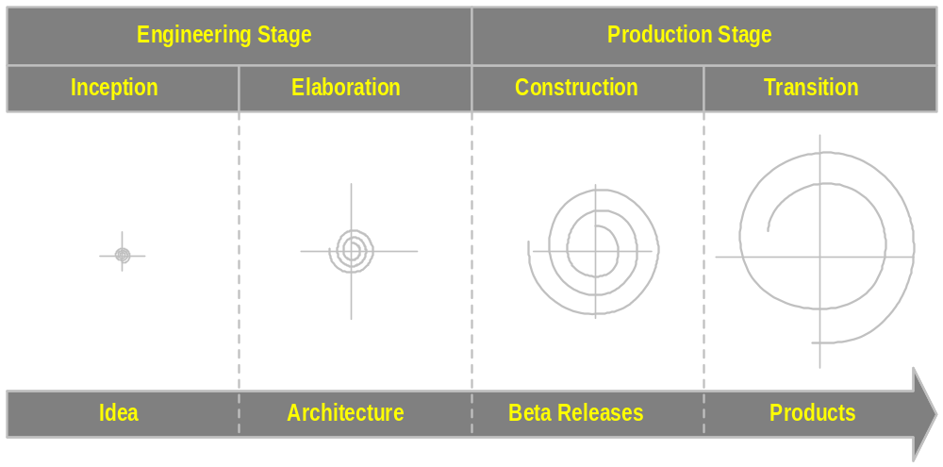
The RUP Iterative Life Cycle
A Commercially Available Spiral Model Implementation
Notes:
The phases of the macroprocess correspond to the spiral model as illustrated in the graphic.
-Inception. For the development of a new product, the main outcome of this phase is a “go-no go” decision to move into the next phase and an investment of time and money to analyze what it is that needs to be built and the feasibility of building it.
-Elaboration. As part of this phase, an executable architecture baseline is evolved in one or several iterations depending on the scope, size, risk, and novelty of the project. This could include the development of one or more exploratory, throw-away prototypes to mitigate specific risks, refine the requirements, perform feasibility and human-interface studies, and demonstrate to investors.
-Construction. This phase is broken down into several iterations, fleshing out the architecture baseline and evolving it toward the final product. At each iteration, the various artifacts prepared during the elaboration phase are expanded and revised, but they ultimately stabilize.
-Transition. This is the phase where the product is put into the hands of its end-users. Efforts include marketing, packaging, installing, configuring, making corrections, and supporting the user community.

Slide 42
Goals and Features of Each Iteration
Each iteration is risk-driven
  performance risks
  integration risks (different vendors, tools, etc.)
  conceptual risks (ferret out analysis and design flaws)
Perform a “mini-waterfall” project
  Ends with a delivery of something tangible in code, available for scrutiny by the interested parties
  The result of a single iteration is an increment

Slide 43
Use Cases Drive the Iteration Process
Inception
Elaboration
Construction
Transition
Iteration 1
Iteration 2
Iteration 3
“Mini-Waterfall” Process
Iteration Planning
Rqmts Capture
Analysis & Design
Implementation
Test
Prepare Release
Copyright © 1997 by Rational Software Corporation
Notes:
52
Each phase is divided into one or more iterations. Each iteration is defined in terms of the scenarios it implements. The classes needed to implement all selected scenarios are developed in a mini-waterfall development process.

Slide 44
The Iteration Life Cycle: A Mini-Waterfall
Selected scenarios
Results of previous iterations
Up-to-date risk assessment
Controlled libraries of models, code, and tests
Iteration Planning
Requirements Capture
Analysis & Design
Implementation
Test
Prepare Release
Release description
Updated risk assessment
Controlled libraries
Copyright © 1997 by Rational Software Corporation
Notes:
53
This is what one single iteration looks like.
As with any waterfall representation of a process, in the mini-waterfall, many of these activities are occurring concurrently. For example, analysis is not done all in one continuous lump. And it intermingles with design and code, etc.

Slide 45
Iteration Assessment
Iteration N Cost and
Schedule Actuals
Iteration N Assessment
Revised Risk List
Compare iteration actual cost, schedule, and content with iteration plan
Determine rework (if any) to be done
  Assign to future iteration(s)
Determine what risks have been eliminated, reduced, or newly identified in this iteration
Update project plan
Prepare detailed plan for next iteration
  Use revised risk list and select appropriate scenarios
Revised Project Plan
Total Cost
Overall Schedule
Scope/Content
Quality Assessment
for Iteration N
Test Results
Defect Density
Architecture Stability
Other metrics
Iteration N+1 Plan
Cost
Schedule
Content
Notes:
This is a critical step in making the iterative approach successful. If it is not done properly, the benefits of the iterative approach will be lessened.
Also, remember that sometimes the right thing to do in this step is to revise the evaluation criteria rather than reworking the system. Sometimes, the benefit of the iteration is in revealing that a particular requirement is not important or is too expensive to implement or creates an unmaintainable architecture. In these cases, a cost/benefit analysis must be done. The decision is a business decision.

Slide 46
Selecting Iterations
In practice, iterations will vary slightly in focus and content across the iterative lifecycle
  Early iterations focus primarily on exploring ideas, consolidating requirements, putting the architecture in place, and getting feedback from stakeholder(s),
  Later iterations focus on making the software product complete and robust.

Slide 47
Selecting Iterations
How many iterations do I need?
  On projects taking 18 months or less, 3 to 6 iterations are typical
Are all iterations on a project the same length?
  Usually
  Iteration length may vary by phase. For example, elaboration iterations may be shorter than construction iterations
Copyright © 1997 by Rational Software Corporation
Notes:
60
There is no “right” answer relative to how many iterations are required. It depends on lots of factors such as the overall project length and the degree of risk involved. For most projects, the answer usually ends up being somewhere between 3 and 6 iterations.

Slide 48
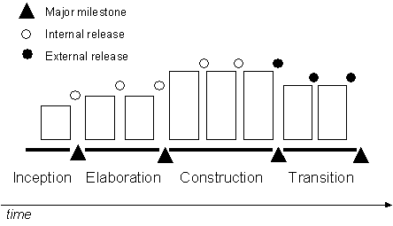
"Typical" RUP Iterations [1, 2, 3, 2]
Notes:
The phases and iterations may look a bit complex at first, but it offers the project manager a very flexible template for organizing a project. Let us look at some variations on the basic "theme."

Slide 49
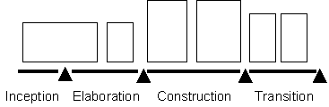
Iterative Lifecycle [0, 2, 2, 2]
If there is no need to explore feasibility, and if the scoping is easy to do, then maybe there is no real iteration in Inception

Slide 50
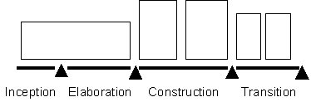
Iterative Lifecycle [0, 1, 2, 2]
If the architecture already exists, and the requirements are stable and well understood, then there may be few or no iterations in Elaboration

Slide 51
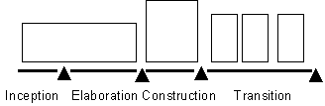
Iterative Lifecycle [0, 1, 1, 3+]
If the product is stable early on and has a solid foundation (architecture), an incremental delivery scheme can be introduced with several deliveries in the Transition phase that provide increasing functionality

Slide 52

Waterfall "Iterative" Lifecycle [0, 0, 0, 1]
And ultimately, the waterfall lifecycle can be described as an iterative lifecycle with only one iteration

Slide 53
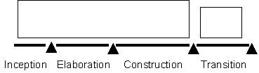
A More Likely Waterfall "Iterative" Lifecycle [0, 0, 1, 1]
There is one iteration to do the job up to the beta release or field trial, and a small iteration to clean up whatever needs to be fixed, completed, or changed
Notes:
Nowadays, the waterfall is rarely 100 percent waterfall, and any non-trivial project needs some form of internal feedback mechanism to do a good job, or to allow some tactical changes of course

Slide 54
There Is No Silver Bullet
Main reason for using the iterative life cycle:
  You do not have all the information you need up front
  Things will change during the development period
You must expect that
  Some risks will not be eliminated as planned
  You will discover new risks along the way
  Some rework will be required; some lines of code developed for an iteration will be thrown away
  Requirements will change along the way
Copyright © 1997 by Rational Software Corporation
Notes:
62
Adopting the iterative approach will not make all your problems go away. It will give you more effective techniques for dealing with them.

Slide 55
When To Sign a Contract
The ideal point in time
  waterfall: when the requirements are all captured, reviewed, approved, and frozen, and top-level design is mostly done
  RUP: at the end of the Elaboration phase
But often this is considered too late: So the alternative is at the end of the Inception phase
A simple Vision Document
OR
A full set of requirements that have not benefited from validation through prototyping in one or more Elaboration iterations.
Notes:
; this is when requirements are fully understood, technical risks are mitigated, and an architecture is in place.

Slide 56
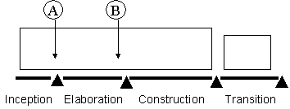
When To Sign a Contract
From a risk management perspective, an unprecedented project (or a project with a large amount of risks) do this in two steps, if the customer is amenable to this variation
a limited first contract at the end of Inception, to cover all the activities of Elaboration, and
a second, firm fixed price contract at the end of Elaboration to cover the rest of development

Slide 57
Outline
Introduction to RUP
Implementing Best Practices
Phases, Iterations, Workflows and Activities
The Iteration Process in RUP
Planning a RUP Project
Tailoring and Implementing RUP
RUP vs. CMMI

Slide 58
How to Develop a Project Plan
RUP clearly distinguishes between project planning and planning for a specific iteration.
  A coarse-grained plan for the entire project
    Define the phase milestones, the number of iterations, and the overall project size estimates.
  A fine-grained plan for each iteration
    Define iteration-specific items such as deliverables, iteration length, risks to be mitigated, activities, assignment of responsibilities, and measurement criteria.

Slide 59
Perform Project Start Activities
Developing a Business Case
  Determining the Economic viability of the project
Identifying and Assessing Risks
Initiating the Project
  Sets up the necessary executive management and project planning teams (if applicable), and also sets out the criteria that will be used to determine when the project has been successfully completed.

Slide 60
Define the Project Organization and Staffing
Defines the project organization based on the characteristics of the project and external constraints, such as existing organizational policy.
  Defining the organizational structure of the project in terms of positions, teams, responsibilities, and hierarchy.
Defines staffing requirements based on the effort estimates for the project, the desired schedule, the chosen organizational structure, and mapping of roles.
  Defining the numbers, type (skills, domain), experience, and caliber of staff required for the project.
  Adjusting the software development team from its baseline as your project moves through its development lifecycle.
Notes:
For instance, your team will normally be heavy on management functions, particularly project management, in the inception phase. When the project moves into the elaboration stage, there will be more architectural staff. In construction, the development staff will be larger. Finally, when your project reaches the transition stage, your team should be heavy on QA or software assessment staff.

Slide 61
Compile the Software Development Plan (SDP)
Defining the Project Structure
  RUP provides key questions whose answers will shed light on the number of iterations required in each phase of your project and the time and effort required for each phase.
Estimating Project Size
  Very difficult…
Notes:
Keep in mind that during the life of your project, the structure may change if phase milestones aren’t passed or if the project runs into problems.

Slide 62
How to Develop Iteration Plans
Once the project manager has completed the coarse-grained project plan, she or he develops an iteration plan at a more detailed level before every iteration.
Each iteration in a phase moves the project toward the phase milestones, and iteration plans are the mechanism by which this movement happens.
An iteration plan defines a clear objective and associates with it the activities required to accomplish that objective.

Slide 63
Consider What Phase You’re In
The phase you’re in helps determine the objective of your particular iteration.
The factors defined earlier in the planning process will help the manager determine which of these objectives to focus on.
Each of these objectives is associated with a deliverable.
Notes:
For example, if the project is in the inception phase, the objectives will be as follows:
1. Establishing the project’s scope and boundary conditions, including an operational vision, acceptance criteria, and what’s intended to be in the product.
2. Exhibiting, and maybe demonstrating, at least one candidate architecture against some of the primary scenarios.
3. Determining the critical use cases of the system, the primary scenarios of operation that will drive the major design trade-offs.
4. Estimating the overall cost and schedule for the entire project (and, in more detail, for the elaboration phase that will immediately follow).
5. Estimating potential risks (the sources of unpredictability).
6. Preparing the supporting environment for the project.

Slide 64
Determine the Deliverable(s)
A deliverable may be something like a vision (of the system) or a series of use cases.
  Produced during that iteration
Each deliverable has associated with it a workflow template identifying the activities, resources, and other deliverables that will be required to complete this deliverable.
It also has associated with it an artifact, meaning the documentation that the project produces for that deliverable and that can be used to review the deliverable at the end of the iteration or workflow.
Notes:
The following deliverables are samples, based on a “normal” RUP project:
‧Business architecture — Describes the business processes and how those business processes are realized within the activity system being investigated. This deliverable is needed only if business modeling is being undertaken.
‧Business case — Provides benefit and cost information about the product being built and defines success criteria for the project.
‧Vision — Defines what the product does, the market it’s aimed at, and the main features of the product.
‧Use case model — Defines the functional requirements of the system.
‧Supplementary requirements — Defines the supplementary or nonfunctional requirements of the system.
‧Use case — Describes a service provided by the system.
‧User interface prototype — Simulates the user interface, as defined and testable by users. This is very important if the system has a very complex GUI or has a series of nonfunctional requirements relating to usability.
‧Analysis model — Identifies key abstractions that make up the system.
‧Subsystem design — Describes the design of subsystems of the analysis model, which will consist of a series of components.
‧Risk list — Describes the risks to be mitigated during each iteration.
‧Component — Consists of an executable unit of code to be deployed in the executable system.
‧Build — Groups a series of components into an entire system.
‧Release — Consists of the particular collection of activities that defines a particular release.
‧Functional test — Tests the functionality needed to meet a particular requirement.
‧Performance test — Tests the performance of the system.
‧Test environment — Sets up the test environment for a particular iteration.
‧Defect/enhancement — Outlines the process for resolving defects or performing enhancements in response to user feedback on the other deliverables.
‧Development environment — Sets up the development environment and manages changes to this environment.

Slide 65
Select the Appropriate Workflow Template
For each deliverable, there’s an associated workflow template in the RUP that identifies the activities required to realize this deliverable.
  An activity includes roles, artifacts, and guidance (help steps).
  Certain activities may project or iteration not be appropriate for your particular, and these can be omitted.
  The amount of time allowed for activities will depend on the total time allocated for this iteration in the project plan.

Slide 66
Associate Resources with Activities
Resources need to be associated with each particular activity in the iteration plan.
The workflow template provides hints as to which resources are required by defining the roles that need to be played in each activity.
The planner must fill the roles with actual workers.

Slide 67
Define Monitoring and Control Processes
How do you know when your project is off track? What do you do to get a wayward project back on course?
To answer these questions, the project manager needs monitoring and control processes that check vital signs of the project with regard to the software development plan.
Typically, the project manager will be concerned with indicators that apply to the project’s scope of work, progress, budget, quality, and risks.
Notes:
Project managers should do the following:
1. Define project indicators to alert the project manager to instigate corrective actions as required.
2. Define sources for project indicators.
3. Define and communicate a procedure and reporting frequency for project team members to report their status.
4. Define thresholds for the project indicators.
5. Define a procedure for project status reporting.

Slide 68
Outline
Introduction to RUP
Implementing Best Practices
Phases, Iterations, Workflows and Activities
The Iteration Process in RUP
Planning a RUP Project
Tailoring and Implementing RUP
RUP vs. CMMI

Slide 69
RUP Has …
4 Phases
9 Core Workflows
31 Roles/Workers
103 Artifacts
136 Activities
15 Tool Mentors
14 Work Guidelines
43 Word/HTML Templates
8 Project Plan Templates
…

Slide 70

Are you Overwhelmed Yet?
The answer is Tailoring
As you sort through the many artifacts, activities and roles in the RUP, you may ask yourself:
  “Do I need this one?”
  “How do I sort through all of these items to determine which ones I need for my project?”
  “Isn’t it obvious that the RUP is only for big projects?”
Notes:
The topic of tailoring addresses all of these questions.

Slide 71
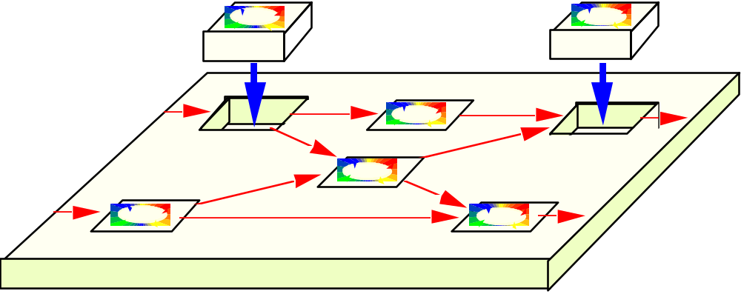
Rational Unified Process: Tailorable
Use in whole or in part
Tailor by creating a project-specific or organization-specific “Development Case”
Development kit - guidelines, tools and templates for customizing the process
Notes:
A software project's purpose is to produce a product. A good process enables the project to produce a product that meets the needs of its stakeholders, on time and within budget. The key to a good process is in tailoring it to be as simple as possible, following a best practices approach.

Slide 72
Development Case
A development case is a static configuration of the RUP; that is, it's tailored to a specific project, product, and organization.
  Focuses on what to do and how to do it.
  Provides an overview of the process to be followed, something understood by everyone on the project. For details, the development case should refer to the RUP and other guidelines or style-guides.

Slide 73
Tailoring: Build a Framework
Do not include activities and artifacts that cannot be clearly justified
Shield your developers from the process
Minimize formal intermediate artifacts
Notes:
Build a Framework First
A common problem for many projects is that they often focus heavily in one particular area, to the extent that they get bogged down with the details of that particular area before making sure that they have a good idea of what "key" elements are involved in the whole process lifecycle of producing a quality product.
It's usually better to address all key elements of a process in a lightweight manner before focusing heavily on any one particular problem area.
Once the framework for a quality software process is in place, a project can effectively focus on a particular area that has been identified as a major contributor to their problems. This selection is based on identifying and prioritizing risks to the project, and determining early mitigation strategies for those identified risks.
Do not include activities and artifacts that cannot be clearly justified
The well-intentioned project manager or process engineer may have a large wish list of nice-to-have metrics, controls, reports, and so on. However, activities and artifacts cost time and money. Some of these costs, such as daily interaction with the environment toolset, may or may not be visible, but simply get folded into lower productivity on standard tasks.
You must distinguish critical process needs from the wish list and determine whether the benefits outweigh the cost.
Shield your developers from the process
You probably have highly trained staff with valuable skills in designing, implementing, and testing. Don't have them spend hours each week filling out forms, enhancing documentation, or fighting with unwieldy tools. If these activities are required, consider having them done by qualified support staff.
Minimize formal intermediate artifacts
The format of intermediate artifacts—those artifacts not intended for the final product—is not as important as the activity and thought needed to produce them. It doesn't matter what they look like, or what tools you use to build them, provided they serve their purpose. As Dwight D. Eisenhower said, “The plan is nothing; the planning is everything.”
One trap that's easy to fall into is formalizing artifacts far too soon. Early versions of artifacts often evolve quickly and remain fluid for some time as different representations while their implications are explored. Formal documentation can impede this process; you can waste a lot of time polishing an artifact that's largely expendable. Hand-drawn diagrams and simple descriptions on index cards are often sufficient in the early stages of an artifact and, for some projects, may be all that's required.
The well-intentioned project manager / process engineer may have a large wish list of "nice to have" metrics, controls, reports, etc. However, activities and artifacts cost time and money. Some of these costs, such as daily interaction with the environment toolset, may or may not be visible, but simply fold into lower productivity on standard tasks.
Distinguish critical process needs from the "nice to have". Determine if the benefits outweigh the cost. You probably have highly trained staff with valuable skills in designing, implementing, and testing. Don't have them spending hours each week filling out forms, gilding documentation, or fighting with unwieldy tools. If these activities are required, then consider farming out these activities to support staff.

Slide 74
Tailoring: Use Convenient Formats
Generate when possible
Use the Web
Use integrated tools
Notes:
An artifact may be tailored so it can be maintained in any form. For example, the Vision document may be captured as a Web page, the Project Plan may be captured as a Microsoft Project file, and the Risk List may be captured as a Rational RequisitePro requirement type.
Generate when possible
Some projects spend a lot of time populating templates of formal documents by manually cutting and pasting information. Instead, consider generating required documents from the source, using tools such as Rational SoDA, or negotiate a simpler way of providing the same information, such as using Rational Rose Publisher to generate a Web-based design model.
In many cases, you can skip an artifact altogether because the information is implicitly provided in the environment. For example, rather than generate the section of the Requirements Management Plan that lists attributes of requirements types, you may want to only provide the tailored Rational RequisitePro project with the applicable requirements types and traceability, and then walk through it with the interested parties. Another example is to provide a read-only version of the Microsoft Project files to the interested parties, rather than duplicating graphics into a separate Software Development Plan.
Use the Web
A useful artifact is one that communicates valuable information. This information should be at the fingertips of those who need it. Web technology is an excellent mechanism for this purpose. If the requirements, design, and implementation are available on the Web, there's no need to generate large sets of quickly obsolesced paper documentation.
Use integrated tools
Select tools that fit the process and tailor the process to fit the tools. The desired results are an easy-to-use process and toolset. Integrated tools generally provide greater consistency, and more informative metrics and reports than tools that are not integrated.

Slide 75
Tailoring: Regularly Revisit the Process
Regularly revisit the process to refine and reduce its complexity.
  If your staff isn't convinced that each step in the process provides added value for the end product, then the process is probably broken.
Tailor while retaining best practices.
Notes:
The RUP encourages tailoring. However, tailoring is not a license to bypass the process altogether. The essentials of the RUP are embodied in its best practices. Follow the spirit of these best practices when tailoring the activities and artifacts to fit your needs.

Slide 76
Reduce the Ceremony
We don’t want methodology priests
We don’t want a methodology board that must approve all artifacts
We don’t want to produce any paper if possible
Notes:
We want a low-ceremony process. Too often, project teams fall victim to ego-centric methodology and process priests. A project may use the services of a “process lead” to get the ball rolling. However, they are not typically a “fixture” on a project. A process lead can float between projects.

Slide 77
The Ten Essentials of RUP
1. Develop a Vision
2. Manage to the Plan
3. Identify and Mitigate Risks
4. Assign and Track Issues
5. Examine the Business Case
6. Design a Component Architecture
7. Incrementally Build and Test the Product
8. Verify and Evaluate Results
9. Manage and Control Changes
10. Provide User Support
“Ten Essentials” list is meant only as a starting point for further discussion!
Notes:
#1 - Requirements Workflow
#2, #3, #4, #5, and #8 - Project Management Workflow
#6 - Analysis and Design Workflow
#7 - Implementation and Test workflows
#9 - Configuration Management Workflow
#10 - Deployment Workflow

Slide 78
Implementing RUP - The Interactive Knowledgebase...
Limited training
Decide what artifacts to produce
Look at the process when you need help producing the artifacts
Benefits increases over time as people start following the process…
Easy to adopt

Slide 79
Implementing RUP : The Full Scale Adoption…
Radical Improvements
“Members become
Mentors”
Further train and mentor each project
Evaluate
Pilot
Large Project 3
Pilot Project
Large Project 2
Large Project 1
Feed-back
Define and
Test a specific
Development Case
Establish
Process and
Support Environment
Development
Case
3-6 months
1 month
1-2 years

Slide 80
Suggestions about Implementation
First Do No Harm
Have onsite Process Mentors
Have people who are good at process design do the process design
Pilot Pieces of the Process
Have a Sales Mentality
Look for Allies
Have Patience and Stamina
…

Slide 81
How to Fail with RUP !!
Step 1: Superimpose “Waterfall” Thinking
  Superimpose Waterfall Phases on the RUP Phases
  Define Iterations Too Long or Too Short
  Polish the Requirements before Design
  Expect Believable Estimates and Detailed Plans Near the Start of a Project
Step 2: Apply the RUP as a Heavy, Predictive Process
Step 3: Avoid Object Technology Skills

Slide 82
How to Fail with RUP !! (cons.)
Step 4: Undervalue Adaptive Iterative Development
  Embrace Rigid and Predictive Attitudes
  Pervert the Practice of Iterative Development
  Don’t Educate Stakeholders in the Implications of Iterative Development
  Over-Model and Create Many Low-Value Artifacts
Step 5: Avoid Mentors Who Understand Iterative Development
Step 6: Adopt the RUP in a Big Bang
Step 7: Take Advice from Misinformed Sources

Slide 83
Outline
Introduction to RUP
Implementing Best Practices
Phases, Iterations, Workflows and Activities
The Iteration Process in RUP
Planning a RUP Project
Tailoring and Implementing RUP
RUP vs. CMMI

Slide 84
Level of Abstraction
Software Process Capability Models
What
CMMI
Software Life Cycle Models
MSF
3W1H
Software Process
RUP

Slide 85
Software Process Capability Models
A capability model is not a process, but a framework for designing, evaluating and improving processes.
In order to maximize their applicability, capability models are designed to be domain and life cycle independent.
  They define work products and specific activities, but only in an abstract sense.
  Selecting a capability model does not define a process; it is only a first step toward designing one.
Notes:
To use a capability model for process definition, an organization needs to adopt a life cycle and then define the work products and practices of the model within the context of that life cycle.

Slide 86
Differences between CMMI and RUP
CMMI provides good guidance on general systems development practices and institutionalization of process practices
RUP provides strong engineering, basic support, and basic project management practices
Organizations using RUP may have need to address
  Statistical process control
  Organizational process elements
  Subcontractor or vendor management practices
  Institutionalization of processes
Notes:
CMMI provides good guidance on general systems development practices and institutionalization of process practices. CMMI could better address
Architecture-related practices
Recursive nature of the process elements in the engineering process areas
“Waterfall” appearance of the engineering process areas
RUP provides strong engineering, basic support, and basic project management practices
Clear definition of roles and responsibilities
Integration of engineering and project management activities
Use of iterations to mitigate risks as early as possible
Validation of requirements and solutions
Focus on early architecture definition and validation
Organizations using RUP may have need to address
Statistical process control
Organizational process elements
Subcontractor or vendor management practices
Institutionalization of processes

Slide 87
Using RUP to Satisfy CMMI Level 2
RUP is valuable framework for satisfying many of the CMMI’s maturity level 2 goals.
  Requirements - CMMI Requirements Management PA
  Project Management - CMMI Project Planning PA, Project Monitoring & Control PA, Process and Product Quality Assurance PA, Measurement and Analysis PA
  Configuration & Change Management - CMMI Configuration Management PA, Measurement & Analysis PA
  Test - Measurement and Analysis PA
The Environment discipline applies to several of the generic practices at CMMI maturity level 2.
The activity Develop Development Case specifically addresses GP 2.2 Plan the Process practice by asking projects to tailor RUP to meet their specific requirements.

Slide 88
Using RUP to Satisfy CMMI Level 2
To fully satisfy CMMI goals, some additional activities must be performed that aren’t specifically called out by RUP:
  Creation of organizational policies that direct the planning and performing of CMMI ML 2 processes
  Creation of detailed standards and procedures that address the day-to-day performance of all system and software engineering activities
  Process-oriented reviews
  Managing suppliers
Notes:
Creation of organizational policies that direct the planning and performing of CMMI ML 2 processes - RUP doesn’t specifically call out the creation of policies by senior management for a project to use as guidance.
Creation of detailed standards and procedures that address the day-to-day performance of all system and software engineering activities - RUP workflows and activities are generally at the process level. Some engineering activities, such as build procedures, project estimation, etc., need to be further documented in more detail.
Process-oriented reviews – RUP calls out several levels of reviews, but they tend to focus on the products created by the software development process. By adding a process review dimension, and documenting the results, an organization can satisfy these CMMI requirements.
Managing suppliers – RUP is designed to be used by an organization that typically develops software products or systems directly for a client organization. Thus, the Supplier Agreement Management Process Area is not specifically addressed by RUP.

Slide 89
CMMI Level 2&3 Acceleration
By adopting RUP, an organization can shortcut the need to internally develop and document several of the required software development processes.
Since the focus of CMMI Level 3 is the organization instead of the project, successful implementation of RUP will significantly reduce the time required to achieve CMMI Level 3
Document As-is Processes
Improve Processes
Institutionalize Processes
Achieve CMMI Level 2
time

